Slide 1
Thesis Project WG1
Statistics and Data Science

Slide 2
Welcome
Thesis project committee
Marjolein Fokkema Chair of this committee, FSW - Methodology & Statistics
Michelle Krens Thesis administration
Carel Peeters WUR – Biometris
Alexander Dürre FWN - Mathematical Institute
Roula Tsonaka LUMC - Biomedical Data Sciences
Mark de Rooij EMOS / Statistics Netherlands, FSW – Meth & Stats

Slide 3
This session
Planning and protocol
Getting started
What to discuss with your supervisor(s)

Slide 4
What should be completed by now
Finished the Preparation course?
Found a project?
Turned in your thesis proposal?
Gained 60 ECTS?

Slide 5
Thesis preparation + project
Preparation of the thesis project (4EC)
Thesis project (30 EC)
Lectures, workshops
Introduction lecture
Write proposal
Find a “thesis working place” and supervisor
Carry out thesis project
Follow thesis working groups
Class on research integrity
Attend a thesis defense
For external project: find a second StatDat supervisor
Give your supervisors the documentation for supervisors
Subscribe to Thesis Project course
Defend thesis
Submit proposal which should be approved by thesis committee and all supervisors
Class on reproducible research
Write thesis proposal which should include three practical working activities
Perform the practical activities in the working environment, and submit reflection forms
Write thesis
Class on scientific writing
10 weeks after starting the thesis project: midway evaluation meeting.
Organize thesis defense

Slide 6
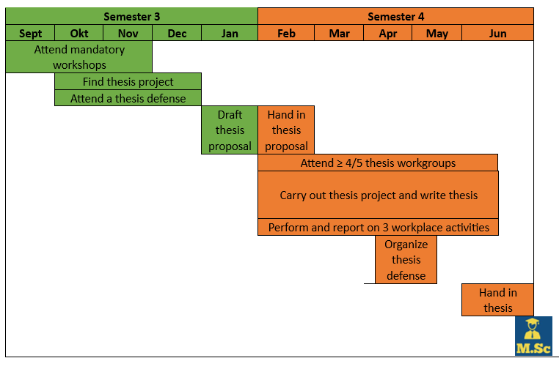
Thesis project timeline

Slide 7
Entry requirements
Entry requirement:
60 ECTS to start the actual thesis project.
Completed all courses (≥ 90 EC, except thesis project) to attend the final examination (thesis defense).

Slide 8
Workplace activities
Get experience as a working statistician or data scientist
Participate in some day-to-day activities
To develop soft skills such as communication, presenting, leadership, organizing
To get more insight in the working place, and to think about your future career path.
You need to select 3 activities, and write a reflection report for each activity.
Daily supervisor will grade with pass/fail.
Need to be submitted before (or at the same time as) the thesis is submitted.

Slide 9
Examples of activities
Participating in journal clubs, research meetings and non-research meetings.
Create an organization chart (organogram).
Make a visualization and/or summary of results of your project for end-users.
Create a tutorial for a method you developed.
Organize or participate in a workshop.
Attend a career event in the field of statistics or data science.
Explain results of statistical analyses to non-statisticians or non-data scientists.
Perform an interview regarding wishes of stakeholders.
Give a presentation at the working place.
Write a letter of application/CV and let it be reviewed by the Human Resources department.
Apply for a job opening at the company you are writing your thesis at.
See Brightspace for more details.

Slide 10
What to discuss with your supervisor(s)
When do you want to defend your thesis?
How often do you meet?
What is most important to you: Higher grade versus finishing soon?
Midway meeting (10 weeks after start of project)

Slide 11
Midway meeting
10 weeks after start of the project, discuss progress with all supervisors:
What has been done so far?
Also: working place activities and skills acquired
How is writing going?
Ideally you should have started. For example, by written (draft of) the Introduction, overview of methods being used, some preliminary results.
Detailed planning of the remaining parts of the project.
Aims and objectives may need adjustment to be attained within project duration!
Plan the midway meeting at the start of your project!

Slide 12
Meeting with supervisor
Make clear arrangements.
Preferably meet at least weekly at a fixed time.
In case of external project, also arrange meetings with second supervisor.

Slide 13
Procedures for thesis defense and graduation
Thesis requirements are on Brightspace.
Procedures for graduation are on Brightspace.
Preparing the thesis defense should start at least 6 weeks before the intended date of defense.

Slide 14
Time plan
Present a feasible time schedule of your activities.
Indicate what elements can be cut / reduced if necessary.
Note that 30 EC corresponds to 21 weeks full time work.
Make a detailed plan (week by week).
At each supervisor-student meeting, compare progress with plan. In case of discrepancies, discuss how to adjust.
Be aware that writing takes time (and therefore start early writing drafts).

Slide 15
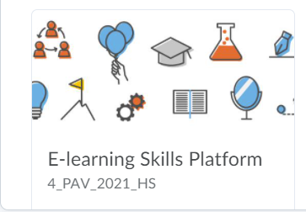
Learning skills platform
For every student at the faculty of Science.
Information, guidelines, tips and tricks on seven skill domains.
Research
Before presenting and writing.
Presentating.
Writing.
Collaboration.
(peer) feedback
Personal and professional development
The platform is accessible via the link: https://brightspace.universiteitleiden.nl/d2l/le/discovery/view/course/27150

